Slide 1
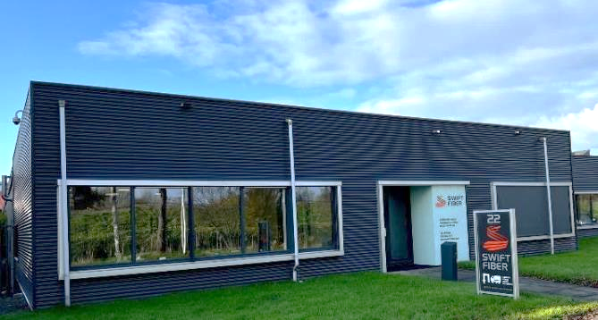


Introduction
SWIFT Fiber
Founded in 2016 in Leeuwarden, The Netherlands
Experienced staff / newest machines
ISO 9001/2015 - certified
Focus on full spectrum of industrial technical yarns & fibers
In house processing for the production of special yarns and fibers
Recycling of technical yarns & fibers

Slide 2
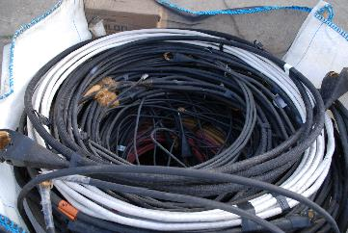
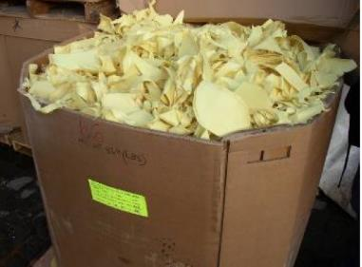
Technical fiber recycling
Recycling of technical yarns and fibers in the form of:
Yarns and fiber waste (spinning or twisting waste)
Obsolete cables (rigging, tensile strength members, fiber optics)
Decommissioned ballistic vests
Used ropes (running rigging, industrial or maritime ropes)
Cut resistant gloves
Weaving waste (selvedge's, edges)
Fabric waste (cut-offs, off-spec rolls)

Slide 3
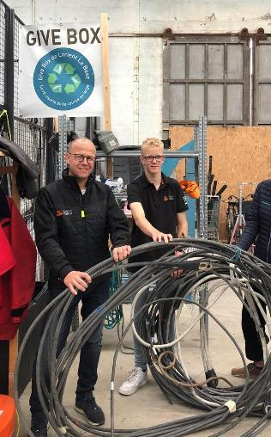
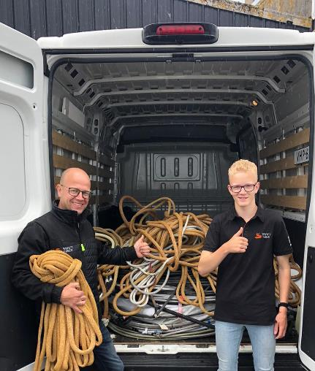
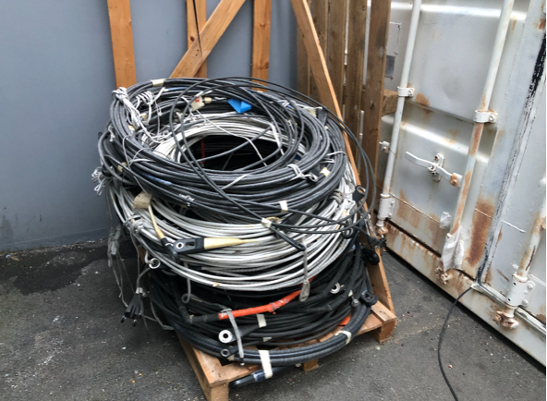
Rigging & rope recycling
Recycling of rigging cables & sailing ropes:
Rigging cables made with PBO/Zylon® or Kevlar®
Ropes with a core of Kevlar®, Technora®, Vectran® or PBO/Zylon®
Ropes with a PBO/Zylon® jacket/cover

Slide 4
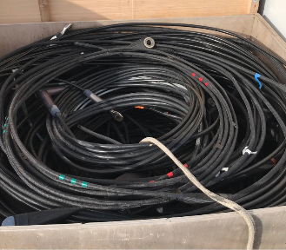
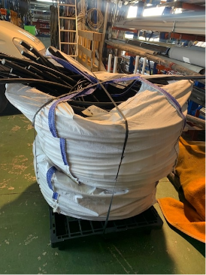
Rigging & rope recycling
How we work:
Cables and ropes are packed by the team on a pallet,
in a box or crate or in bulk bags
We are being informed with the dimensions and the weight
SWIFT Fiber plans, arranges and pays for the transport
to our facility in NL
We process the ropes and cables
We inform you about the net weights and pay accordingly
€ 5,00 for every kg of PBO/Zylon® and € 1,00 for every kg of Kevlar®

Slide 5
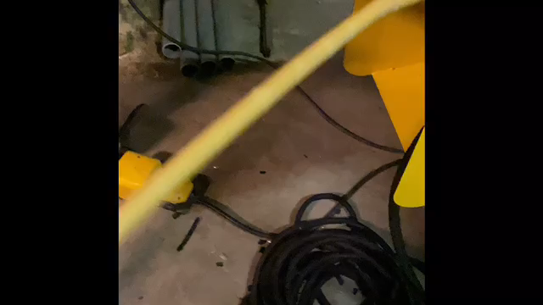
Rigging & rope recycling
Impression of the actual stripping of the cables:

Slide 6
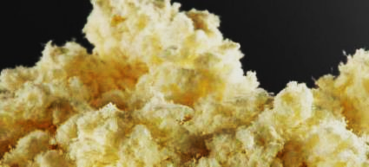
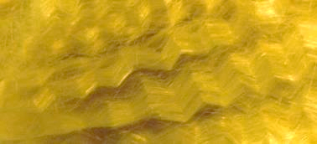
Technical fiber recycling
From waste to new raw material
Sorting and selecting
Reclaiming yarns
Cleaning, washing, cutting, pulling, milling
End product
- Milled fiber
- Short cut fiber
- Pulp

Slide 7
Technical fiber recycling
Re-use of short cut fiber, milled fiber and pulp in:
Spinning of new staple fibre yarns for f.i.:
- heat resistant gloves
- industrial oven seals
Reinforcing plastics and rubbers
Technical papers
Brake pads (cars, trucks and motor)

Slide 8
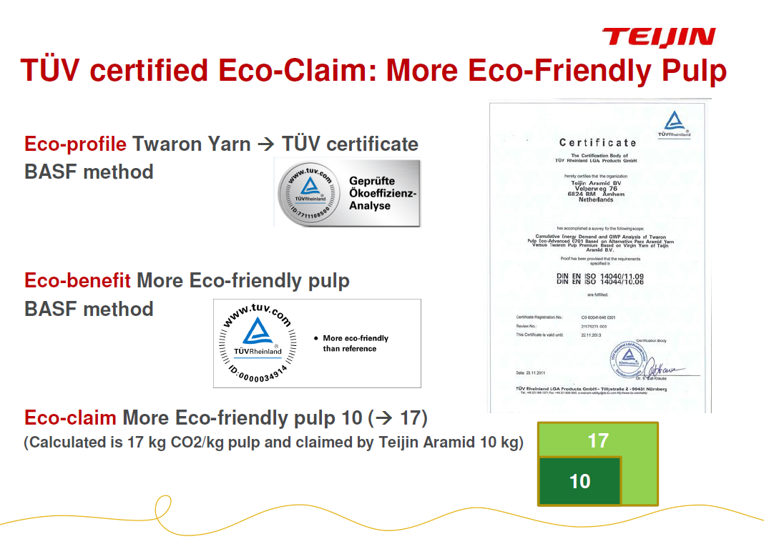
Technical fiber recycling
Use of recycled para-aramid vs virgin para-aramid in par-aramid pulp
Reduction from 17 kg to 10 kg CO² per kg para-aramid pulp produced

Slide 9
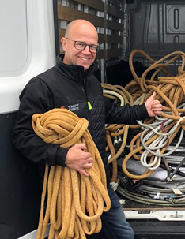
How may we help you?
Please contact:
SWIFT Fiber
Mr. Bart Broos
Edisonstraat 22
8912 AW Leeuwarden, The Netherlands
 +31 85 065 31 12
 +31 6 23 97 26 52
bbroos@swift-fiber.com
www.swift-fiber.com

